Slide 1
DATA VISUALIZATION
16.05.2022

Slide 2
Combination TECHNIQUES
In addition to the techniques based on points, lines, or regions, there are a number of hybrid techniques that combine features of two or more of these classes. We describe two of the more popular techniques of this type: glyphs and dense pixel displays.
In the context of data and information visualization, a glyphs is a visual representation of a piece of data or information where a graphical entity and its attributes are controlled by one or more data attributes.
As an example, the width and height of a box could be controlled by a student’s score on the midterm and final exam for a course, while the color could be associated with the gender of the student.

Slide 3
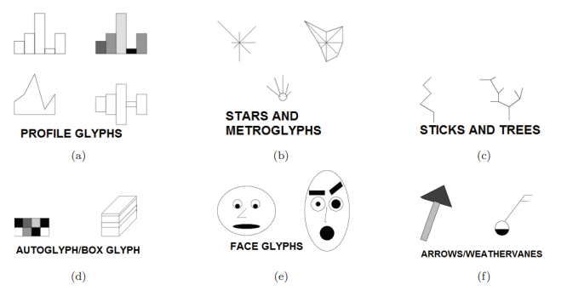
GLYPHS
A glyph is any marker, such as an arrow or similar marking, used to specify part of a visualization.
This is a representation to visualize data where the data set is presented as a collection of visual objects. These visual objects are collectively called a Glyph.

Slide 4
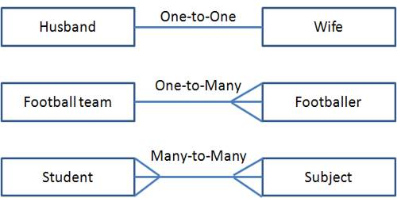
MAPPING
A wide range of possible mappings for data glyphs are discussed, including:
• one-to-one mappings, where each data attribute maps to a distinct and different graphical attribute;
• one-to-many mappings, where redundant mappings are used to improve the accuracy and ease with which a user can interpret data values; and
• many-to-one mappings, where several or all data attributes map to a common type of graphical attribute, separated in space, orientation, or other transformation.

Slide 5
Different types of mapping
One-to-one mappings are often designed to take advantage of the user’s domain knowledge, using intuitive pairings of data to graphical attributes to ease the learning process. Examples include mapping color to temperature, and flow direction to line orientation.
Redundant mappings can be useful in situations where the number of data dimensions is low and the desire is to reduce the possibility of misinterpretation. For example, one might map population to both size and colour to ease analysis for color-impaired users, and to facilitate comparison of two populations with similar values.
Many to-one mappings are best used in situations where it is important to not only compare values of the same dimension for separate records, but also to compare different dimensions for the same record.

Slide 6
Types of glyphs
The following list contains a subset of glyphs that have been proposed in the literature or are in common use. Some are customized to a particular application, such as visualizing fluid flow, while others are more general purpose.
• profiles — height and color of bars;
• stars — length of evenly spaced rays emanating from center;
• Anderson/metroglyphs — length of rays;
• stick figures — length, angle, color of limbs;
• trees —length, thickness, angles of branches; branch structure
• derived from analyzing relations between dimensions;
• autoglyph — color of boxes;
• boxes —height, width, depth of first box; height of successive
• boxes;

Slide 7
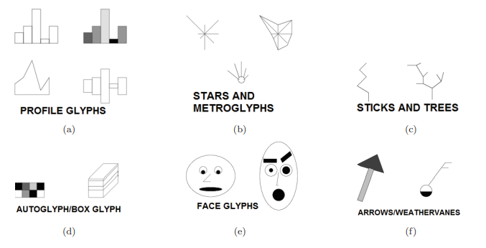

Slide 8
Examples of multivariate glyphs
• faces —size and position of eyes, nose, mouth; curvature of mouth; angle of eyebrows;
• arrows—length, width, taper, and color of base and head;
• polygons—conveying local deformation in a vector field via orientation and shape changes;
• dashtubes —texture and opacity to convey vector field data;

Slide 9
Ordering strategies
Once a glyph design is chosen, there are N! different dimension orderings that can be used in the mapping. Which ones are likely to reveal the most interesting features? Several ordering strategies can be imagined:
• Dimensions could be ordered according to their correlation, so that similar dimensions are mapped adjacent to each other. This can help reveal general trends, as well as expose some outliers.
• Dimensions can be mapped in such a way as to promote symmetrically shaped glyphs, which can be easier to perceive and remember. Shapes that are less symmetric than their neighbours will also stand out.

Slide 10
Ordering strategies
• Dimensions can be sorted according to their values in one record. For example, if the data represents a multivariate time series, sorting the dimensions based on the first record can make the trends over time more pronounced, conveying which dimensional relationships were maintained versus those that changed significantly.
Dimensions can be manually sorted, based on the user’s knowledge of the domain. Thus, semantically similar dimensions can be grouped or used for symmetric glyph features, which can simplify the interpretation.

Slide 11
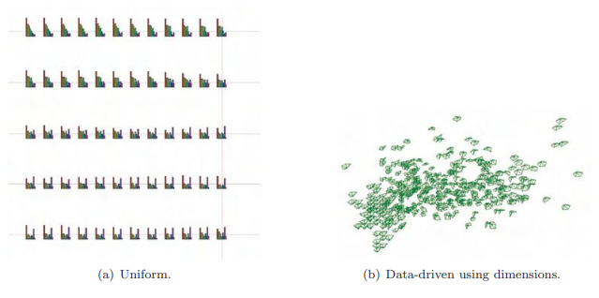

Slide 12
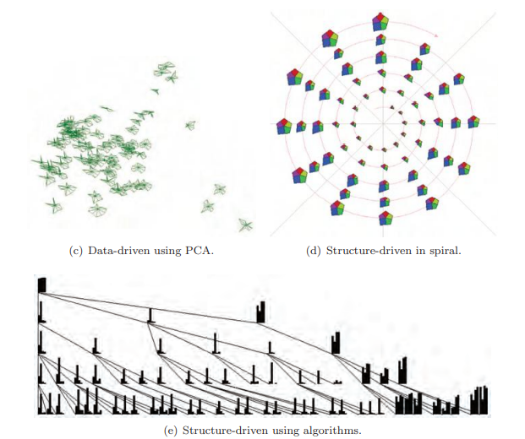

Slide 13
Glyph based layout strategies
A final important consideration in designing a glyph-based visualization is the layout of the glyphs on the screen. There are three general classes of layout strategies:
Uniform: glyphs are scaled and positioned with equal space between them to occupy the entire screen. This strategy eliminates overlaps, while making efficient use of the screen space. Different orderings of records can expose different data features.
Data-driven: data values are used to control the positioning of the glyphs. Two approaches are possible. In the first, two data dimensions (or three for 3D display) are chosen to set the locations.
Structure-driven: if the data has an implicit or explicit structure to it, such as cyclic or hierarchical, this can be used to control the positioning

Slide 14
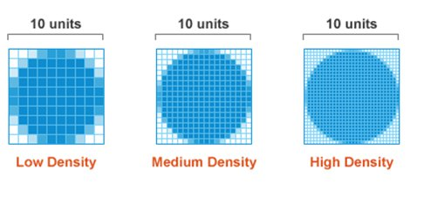
DENSE PIXEL DISPLAYS
Dense pixel displays (also known as pixel-oriented techniques) are a hybrid between point-based and region-based methods.
The displays make maximal use of the screen space, allowing data sets with millions of values to be shown on a single screen.
Each data value will control the color for a single pixel; changing the color map used can potentially reveal new features of the data

Slide 15
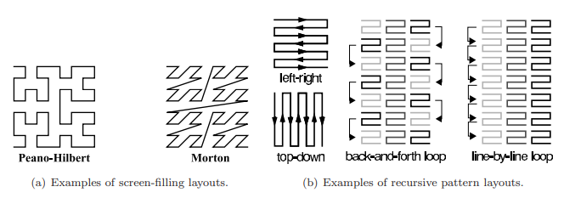
DENSE PIXEL DISPLAYS
The final major issue with pixel-oriented displays is the data ordering. For some data, such as time series, the order is predetermined and fixed.
In other cases, however, reordering the records can expose many interesting features. For example, if the records are ordered based on one of the dimensions, clusters of values within that dimension will be revealed, as will other dimensions having similar clusters.

Slide 16
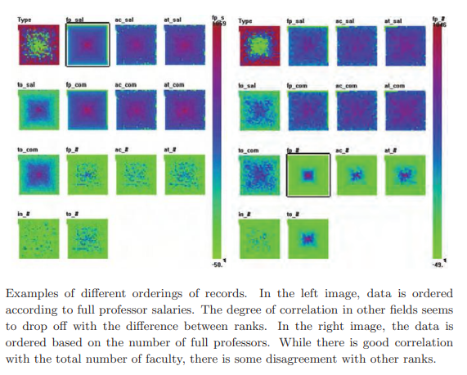

Slide 17
Visualization Techniques for Trees, Graphs, and Networks
While most of the visualization techniques discussed thus far focus on the display of data values and their attributes, another important application of visualization is the conveying of relational information, e.g., how data items or records are related to each other. These interrelationships can take many forms:
• part/subpart, parent/child, or other hierarchical relation;
• connectedness, such as cities connected by roads or computers connected by networks;
• derived from, as in a sequence of steps or stages;
• shared classification;
• similarities in values;
• similarities in attributes (e.g., spatial, temporal)

Slide 18
Relationships
Relationships can be simple or complex: unidirectional or bi-directional, Non weighted or weighted, certain or uncertain. Indeed, the relationships may provide more and richer information than that contained in the data records.
Applications for visualizing relational information are equally diverse, from categorizing biological species, to exploring document archives.

Slide 19
Trees or hierarchies
Trees or hierarchies (we’ll use the terms interchangeably) are one of the most common structures to hold relational information. For this reason, many visualization techniques have been developed for display of such information. We can divide these techniques into two classes of algorithms: space-filling and non–space-filling.
HIERARCHIES
SPACE FILLING
NON SPACE FILLING

Slide 20
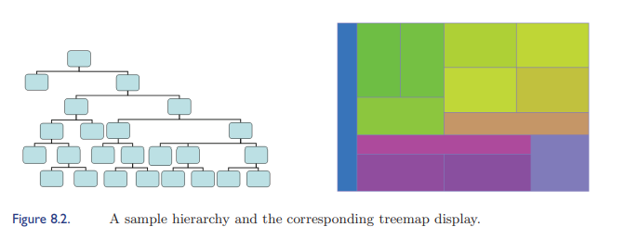
CONTD.
As the name implies, space-filling techniques make maximal use of the display space. This is accomplished by using juxtapositioning to imply relations, as opposed to, for example, conveying relations with edges joining data objects. The two most common approaches to generating space-filling hierarchies are rectangular and radial layouts.
Treemaps and their many variants are the most popular form of rectangular space-filling layout. In the basic treemap, a rectangle is recursively divided into slices, alternating horizontal and vertical slicing, based on the populations of the subtrees at a given level.

Slide 21
Variations of tree maps
As mentioned, many variants on treemaps have been proposed and developed since they were introduced, including squarified treemaps (to reduce the occurrence of long, thin rectangles) and nested treemaps (to emphasize the hierarchical structure).
The methods described above are structured using horizontal and vertical divisions to convey the hierarchy. A number of other approaches are possible, however, such as those that divide space radially.
Radial space-filling hierarchy visualizations, sometimes referred to as sunburst displays, have the root of the hierarchy in the center of the display and use nested rings to convey the layers of the hierarchy.
Each ring is divided based on the number of nodes at that level. These techniques follow a similar strategy to treemaps, in that the number of terminal nodes in a subtree determines

Slide 22
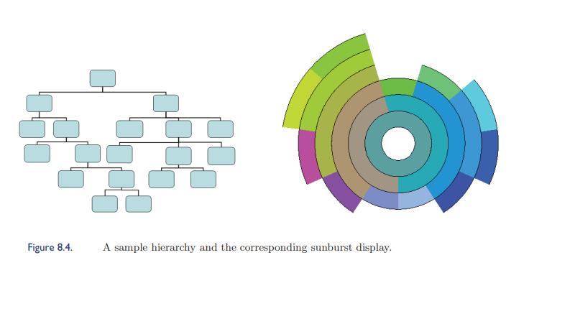
Simple hierarchy and sunburst display

Slide 23
Summary of space filling techniques
However, unlike tree maps, which assign most screen space to conveying the terminal nodes, radial techniques also show the intermediate nodes.
For these and other space-filling techniques, color can be used to convey many attributes, such as a value associated with the node (e.g., classification) or it may reinforce the hierarchical relationships, e.g., siblings and parents may have similarities in color.
Symbols and other markings may also be embedded in the rectangular or circular segments to communicate other data features.

Slide 24
Non space filling methods
The most common representation used to visualize tree or hierarchical relationships is a node-link diagram. Organizational charts, family trees, and tournament pairings are just some of the common applications for such diagrams.
The drawing of such trees is influenced the most by two factors: the fan-out degree (e.g., the number of siblings a parent node can have) and the depth (e.g., the furthest node from the root).
Trees that are significantly constrained in one or both of these aspects, such as a binary tree or a tree with only three or four levels, tend to be much easier to draw than those with fewer constraint

Slide 25
Designing and algorithm
When designing an algorithm for drawing any node-link diagram (not just trees), one must consider three categories of often-contradictory guidelines: drawing conventions, constraints, and aesthetics.
Conventions may include restricting edges to be either a single straight line, a series of rectilinear lines, polygonal lines, or curves. Other conventions might be to place nodes on a fixed grid, or to have all sibling nodes share the same vertical position.
Constraints may include requiring a particular node to be at the centre of the display, or that a group of nodes be located close to each other, or that certain links must either go from top to bottom or left to right. Each of the above guidelines can be used to drive the algorithm design

Slide 26
Aesthetics
Aesthetics, however, often have significant impact on the interpretability of a tree or graph drawing, yet often result in conflicting guidelines. Some typical aesthetic rules include:
• minimize line crossings
• maintain a pleasing aspect ratio
• minimize the total area of the drawing

Slide 27
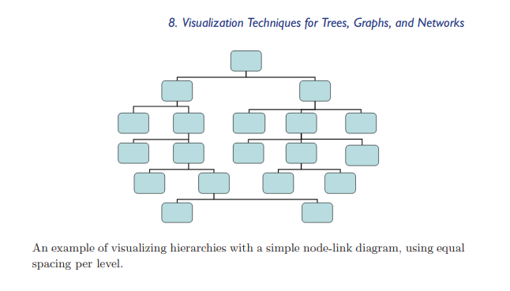

Slide 28
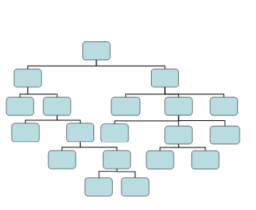

Slide 29
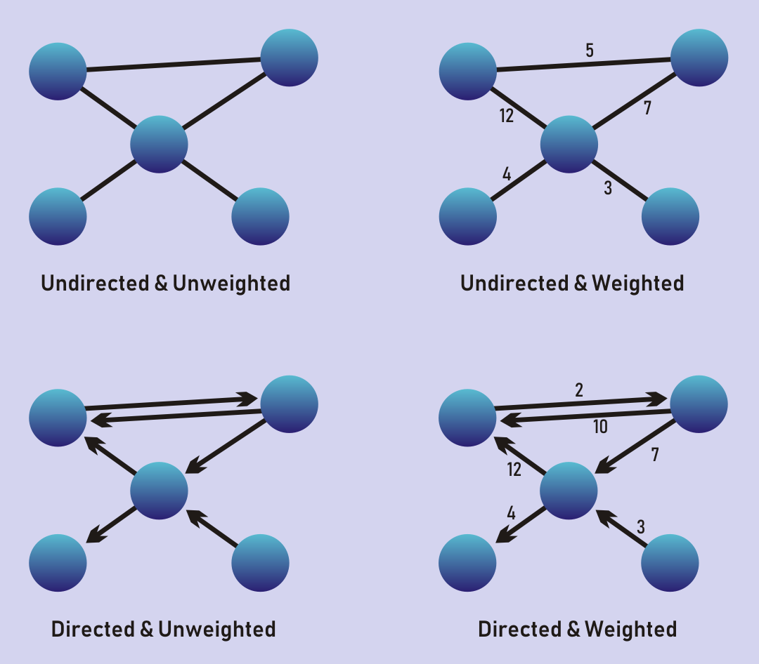
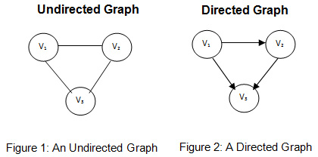
Types of graphs

Slide 30
RULES FOR NON SPACE FILLING METHODS
An example of visualizing hierarchies with a simple node-link diagram, using equal
spacing per level.
• minimize the total length of the edges
• minimize the number of bends in the edges
• minimize the number of distinct angles or curvatures used
• strive for a symmetric structure

Slide 31
ALGO
For trees, especially balanced ones, it is relatively easy to design algorithms that adhere to many, if not most, of these guidelines. For example, a simple tree drawing procedure is given below (sample output is shown in
1. Slice the drawing area into equal-height slabs, based on the depth of the tree.
2. For each level of the tree, determine how many nodes need to be drawn.
3. Divide each slice into equal-sized rectangles based on the number of nodes at that level.
4. Draw each node in the center of its corresponding rectangle.
5. Draw a link between the center-bottom of each node to the center-top
of its child node(s)

Slide 32
ENHANCEMENTS
• Rather than using even spacing and centering, divide each level based on the number of terminal nodes belonging to each subtree.
• Spread terminal nodes evenly across the drawing area and center parent nodes above them.
• Add some buffer space between adjacent nonsibling nodes to emphasize relationships.
• If possible, reorder the subtrees of a node to achieve more symmetry and balance.
• Position the root node in the center of the display and lay out child nodes radially, rather than vertically.

Slide 33
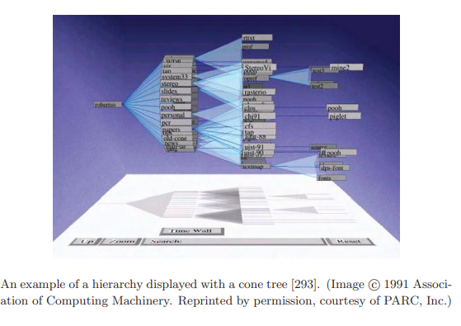

Slide 34
Displaying Arbitrary Graphs/Networks
Trees are just one type of a more general representation of relations called a graph. Technically speaking, a tree is a connected, unweighted, acyclic graph. Clearly, there are many other possibilities, including graphs with weighted edges, undirected graphs, graphs with cycles, disconnected graphs, and so on.
Rather than give more algorithms specific to other classes of graphs, which could certainly fill more than a textbook, we will describe some general approaches for visualizing graphs in which the class or structure is not known, which we term an arbitrary graph.
For our purposes, we will assume that the graph is undirected, though some of the techniques presented are easily extended to directed graphs. We will look at two distinct graph drawing approaches: node-link diagrams (building on the material from the previous section) and matrix displays

Slide 35
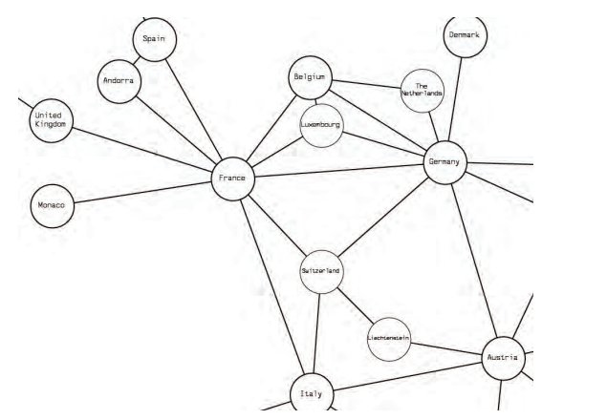
Node-Link Graphs
Force-directed graph drawing methods use a spring analogy to represent the links, with node positions iteratively refined until the overall energy or stress of the system is minimized.
For each pair of connected nodes, there are two forces: fij , the force caused by the spring between them, and gij , an electrical repulsion force to keep nodes from getting too close.

Slide 36
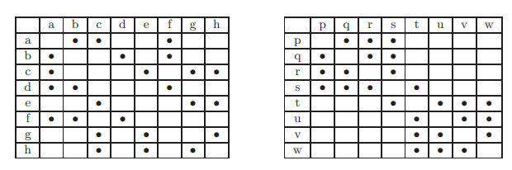
Matrix Representations for Graphs
An alternate visual representation of a graph is via an adjacency matrix, which is an N by N grid (where N is the number of nodes), where position (i, j) represents the existence (or not) of a link between nodes i and j.
here have been numerous algorithms proposed for reordering the rows and columns of the matrix to expose the most structure. Some are primarily user-driven, which would support ordering based on the values in one of the rows or columns as a starting point.

Slide 37
LABELLING
Proper labelling of a visualization is crucial to allow a viewer to understand what is being shown.
A map would be of little value without some form of labeling; similarly, a color-coded plot would be difficult to understand without some indication of the meaning associated with the colours.
In tree and graph drawing, the problem of labeling is compounded, not only because of the potential for many nodes, but also because labels might also be needed for the links between nodes.

Slide 38
CONTD.
If there are only a small number of distinct labels, such as showing the type of link or a class associated with a node, it is best to use nontextual labels, such as the color, size, or shape of a node or the color, thickness, or line style of a link.
This does not require much screen space and can usually be interpreted unambiguously even in the presence of modest amount of line crossing and node occlusion.
However, if the number of distinct labels exceeds five or six, the likelihood of misinterpretation can become large. A key for interpreting the graphical attribute mapping is essential.

Slide 39
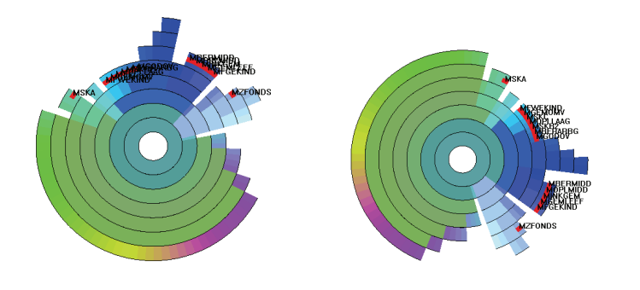
Improving the readability of labels via rotation.

